Slide 1


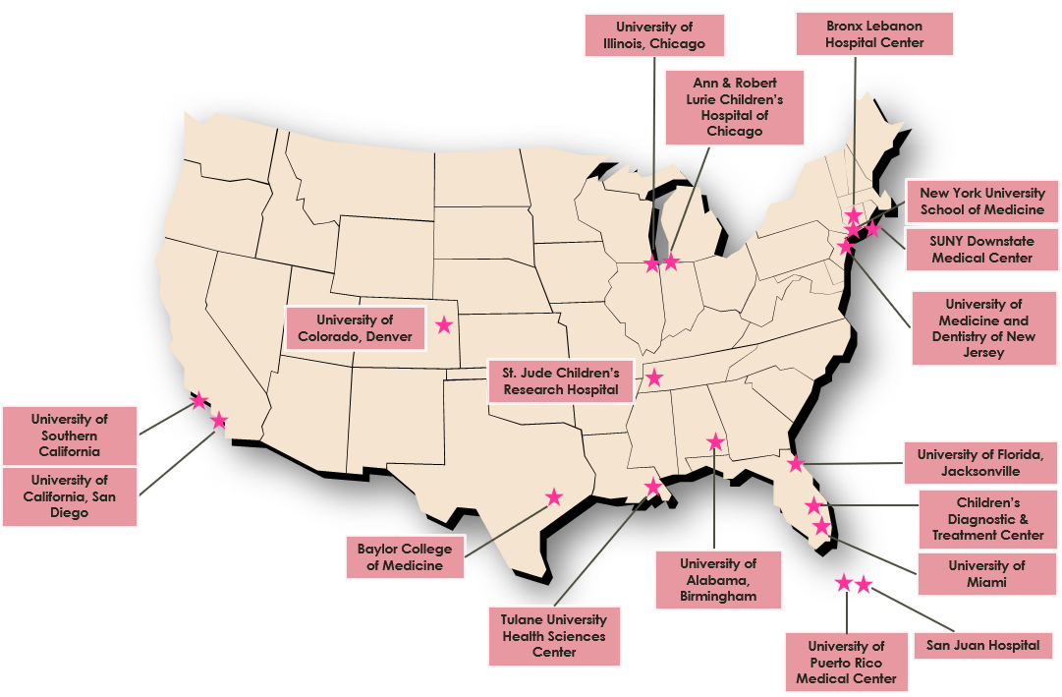





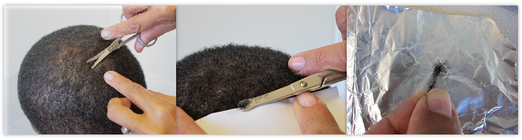
Extent of in utero transfer of tenofovir from mother to fetus: a paired analysis of hair specimens collected at birth from a cohort in the United States
PEB0277
Jillian Pintye ¹, Yanling Huo ², Deborah Kacanek ², Kevin Zhang ³, Karen Kuncze ³, Hideaki Okochi ³, Monica Gandhi ³ for the Pediatric HIV/AIDS Cohort Study (PHACS)
¹ University of Washington; ² Harvard TH Chan School of Public Health; ³ University of California San Francisco *contact: jpintye@uw.edu
Background
Results
PHACS Sites
As efforts intensify to eliminate vertical HIV transmission, and pre-exposure prophylaxis use burgeons among women of reproductive age, the likelihood of women receiving tenofovir (TFV)-based regimens during pregnancy increases.
Understanding pharmacokinetics of in-utero TFV transfer is critical for interpreting safety.
To evaluate in-utero TFV transfer, we measured TFV hair levels at delivery among women living with HIV (WLHIV) receiving tenofovir disoproxil fumarate-based antiretroviral therapy (ART) and their infants in the United States.
Figure 2. SMARTT participants from June 2014 to July 2016 with maternal-infant hair collected and tested for TFV concentrations
Table 1. Pregnancy characteristics (n=103)
Characteristic | % or Median (IQR)
Maternal age (years) |  | 32 (26-36)
Preterm delivery |  | 10%
C-section delivery |  | 54%
Last HIV RNA in pregnancy ≥400 copies/mL |  | 8%
NNRTI use during pregnancy |  | 32%
PI use during pregnancy |  | 57%
INSTI use during pregnancy |  | 37%
Cumulative TDF use in pregnancy, weeks |  | 32 (22-38)
Pregnancies with both maternal and infant hair specimen collected (n=267) ¹
Maternal and/or infant hair specimen not tested for TFV: n=151 (146 maternal; 5 infant)
Reasons for not testing
Insufficient maternal hair sample (n=146, 97%)
Not enough infant hair for analysis (n=3, 2%)
Infant hair internal standard <0.5 of avg peak area (n=2, 1%)
Pregnancies with both maternal and infant hair specimen tested for TFV (n=116)
Maternal TFV hair level <LLQ: n=10
Twin gestation: n=3 ²
Singleton pregnancies (mother-infant pairs) with both maternal and infant TFV hair concentration available: (n=103) ³
Methods
¹ Including 1 repeat pregnancy and 6 twin-pregnancies (1 twin-pregnancy had hair collected for only 1 infant); ² For 1 twin-pregnancy, hair were collected for both infants but were tested for only one infant; ³ 2 mother-infant pairs with infant hair levels <LLQ; 82 pairs with infant levels >ULQ; 1 pair with maternal level >ULQ
NNRTI = non-nucleoside reverse transcriptase inhibitors; PI = protease inhibitor; INSTI = integrase strand transfer inhibitor; TDF = tenofovir disoproxil fumarate
Conclusions
Hair samples were collected at or shortly after childbirth among WLHIV and their infants enrolled in the Surveillance Monitoring for ART Toxicities (SMARTT) Study of the Pediatric HIV/AIDS Cohort Study (PHACS) between 6/2014-7/2016.
Among those on TFV disoproxil fumarate (TDF)-based ART during pregnancy, TFV hair levels were analyzed using validated liquid chromatography/tandem mass spectrometry method in the UCSF Hair Analytical Laboratory (HAL).
Lower limit of quantification (LLQ) was 0.00200 ng/mg. Weight-normalized TFV hair concentrations were log-transformed.
We calculated individual ratios of infant-to-maternal hair TFV concentrations to determine degree of transfer and Spearman correlation coefficients.
Table 2. Maternal-infant TFV hair concentrations (n=103) ¹
Table 3. Correlates of log₁₀-transformed ratios of infant-to-mother TFV concentrations (N=103) ³
Similar to prior studies that assessed in-utero TFV exposure via short-term metrics, we found high rates of TFV transfer, with our study confirming that such transfer is cumulative.
Transfer was lower among mothers who delivered preterm, those with only 1st trimester TDF use, and those with C-section deliveries in our study.
There was a trend towards lower TFV transfer with receipt of INSTIs, though our results should be interpreted with caution.
This methodology can be employed for other ART agents commonly used in pregnancy to help maximize their efficacy while minimizing safety concerns.
 | Mean (SD) | Mean (SD) |  | Median (IQR)
Maternal TFV hair concentrations
Weight-normalized (ng/mg) | 0.04 (0.06) |  |  | 0.02 (0.01, 0.04)
Log₁₀ weight-normalized | -1.64 (0.46) |  |  | -1.68 (-1.91, -1.37)
Infant TFV hair concentrations
Weight-normalized (ng/mg) | 0.35 (0.12) | 0.35 (0.12) | 0.35 (0.12) | 0.40 (0.40, 0.40)
Log₁₀ weight-normalized | -0.55 (0.45) | -0.55 (0.45) | -0.55 (0.45) | -0.40 (-0.40, -0.40)
Infant-to-mother ratio
Log₁₀ TFV hair concentration ratio | 1.08 (0.58) | 1.08 (0.58) | 1.08 (0.58) | 1.21 (0.83, 1.40)
 | Mean log₁₀ ratio of transfer ¹ | % Change ² (95% CI) | p-value
Preterm delivery
Yes | 0.72 | -60.3 (-83.2, -6.2) | 0.04
No | 1.12 | Ref.
Mode of delivery
C-section | 0.98 | -42.0 (-65.4, -2.7) | 0.04
Vaginal delivery | 1.21 | Ref.
Infant hair color
Black | 1.14 | 101.6 (2.9, 294.6) | 0.04
Other/Mixed | 0.83 | Ref.
Graduated high school
Yes | 1.15 | 72.8 (-1.6, 203.4) | 0.06
No | 0.92 | Ref.
NNRTI use in pregnancy
Yes | 1.17 | 34.2 (-24.2, 137.5) | 0.31
No | 1.04
PI use in pregnancy
Yes | 1.02 | -27.4 (-57.6, 24.2) | 0.24
No | 1.16
INSTI use in pregnancy
Yes | 0.96 | -36.3 (-63.2, 10.0) | 0.10
No | 1.15
TDF use in 1st trimester only
Yes | -0.28 | -95.9 (-99.3, -75.7) | <0.001
No | 1.11 | Ref.
¹ For pregnancies with infant hair level < LLQ, the value LLQ (=0.002 ng/mg) was used; for pregnancies with hair level > ULQ the value ULQ (=0.4 ng/mg) was used.
Figure 3. Maternal by infant Log₁₀ TFV hair levels at birth (N=103)
Acknowledgments
Figure 1. Hair collection process
We thank the study participants, clinical sites, PHACS CAB, Frontier Science & Technology Research Foundation, and Westat.
This study was funded by the National Institute of Allergy and Infectious Diseases (R21AI138618, 2RO1AI098472) with support from the University of Washington Center for AIDS Research (P30 AI027757). The Pediatric HIV/AIDS Cohort Study (PHACS) was supported by the Eunice Kennedy Shriver National Institute Of Child Health & Human Development (NICHD) with co-funding from the National Institute Of Dental & Craniofacial Research (NIDCR), NIAID, the National Institute Of Neurological Disorders And Stroke (NINDS), the National Institute On Deafness And Other Communication Disorders (NIDCD), Office of AIDS Research (OAR), the National Institute Of Mental Health (NIMH), the National Institute On Drug Abuse (NIDA), and the National Institute On Alcohol Abuse And Alcoholism (NIAAA), through cooperative agreements with the Harvard T.H. Chan School of Public Health (HD052102) and the Tulane University School of Medicine (HD052104).
¹ Estimated unadjusted mean log10-transformed infant-to-mother TFV concentration ratio for mother-infant pair with a specific characteristic; ² Estimated percent change in unadjusted mean log10-transformed infant-to-mother TFV concentration ratio between pairs with a specific characteristic vs the reference group;³ Models were based on unique pregnancy with maternal hair level > LLQ; for pregnancies with infant hair level < LLQ (n=2), the value LLQ (=0.002 ng/mg) was used in calculating the ratio; for pregnancies with hair level > ULQ (1 maternal hair; 82 infant hair), the value of ULQ (=0.4 ng/mg) was used.
Notes:
Poster Development Guide
Formatting Notes
To Edit In PowerPoint: Click View > Guides to make editing easier. Keep text within guides
If you wish, you may change the background colors, but use a light color or white for the overall background of the poster and a bold color for the main findings section
Author list: Don’t split names onto two lines (e.g., “John [line break] Smith”). If that happens, use a new line. Bold the name of the presenting author
Font Size: Do not drop below font size 36 in the main information sections (Background, Methods, Results, Conclusions). If you have extra space, increase the font size, but maintain some white space to make it easier for attendees to read your text
Use of Color: To keep attendees focused on your main findings and important details in your graphs and figures, do not use color in the sidebars
Print Size: Using this template, the optimal print size is 54 inches (width) x 36 inches (height) or 60 inches x 40 inches (137.2 cm x 91.4 cm or 152.4 cm x 101.6). Printing the poster in a smaller size may save some cost, but the 54” x 36” size will maintain the suggested font size and layout in the final printed version of the poster (and maintain the effectiveness of the poster design).
Poster Board Dimensions: Regardless of whether you use this template, the size of the board for displaying your poster at CROI is 96 inches (width) x 48 inches (height). The maximum size of a poster is 93 inches (width) x 45 inches (height). The minimum size for a poster is 36 inches (width) x 24 inches (height) so attendees can see the poster at a minimum of 10 feet away
Poster Content Requirements
Poster Number: The poster number should be displayed in the upper right corner (0000 in the template). This is not the abstract number you had during submission but a number you will be assigned and sent to you by email which notes the position of the poster in the poster hall. This number will be sent to you after late-breaking abstracts have been accepted in January
Poster Title: The title should be the same as the title submitted with the abstract
QR Codes are not allowed by CROI

